Slide 1

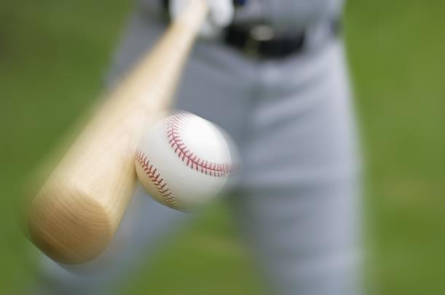
Project 2: Machine Learning Models and Predictive Analytics in Sports

Slide 2
Agenda
Introduction & Executive Summary
Modelling Basketball Outcomes
Modelling Baseball Outcomes
Conclusions

Slide 3
Introduction
Statistics and Predictions in Professional Sports
Fan Participation: Fantasy Leagues and Gambling
Two Demonstrations of Predictive Analytics:
Basketball
Baseball

Slide 4
EXECUTIVE SUMMARY
Baseball Predictive Results:
The Game Winner Can be predicted up to 95% accuracy by the end of the 8th Inning, and up to 80% Accuracy by the end of the 5th Inning.
Basketball Predictive Results:

Slide 5
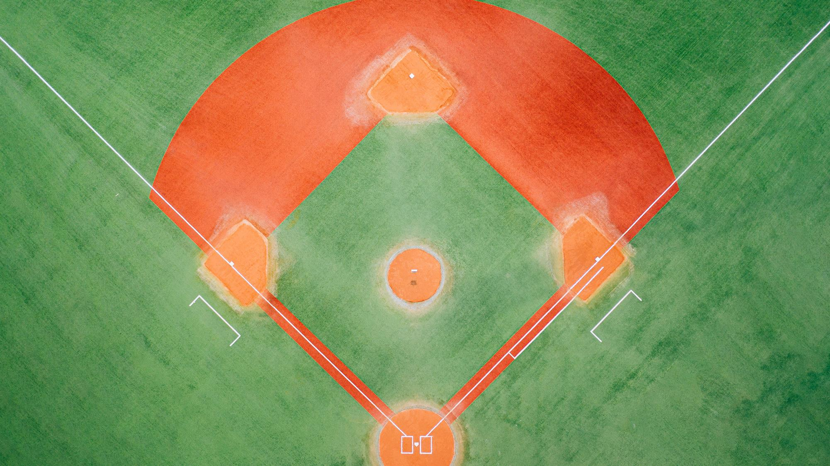
Baseball Predictive Model

Slide 6
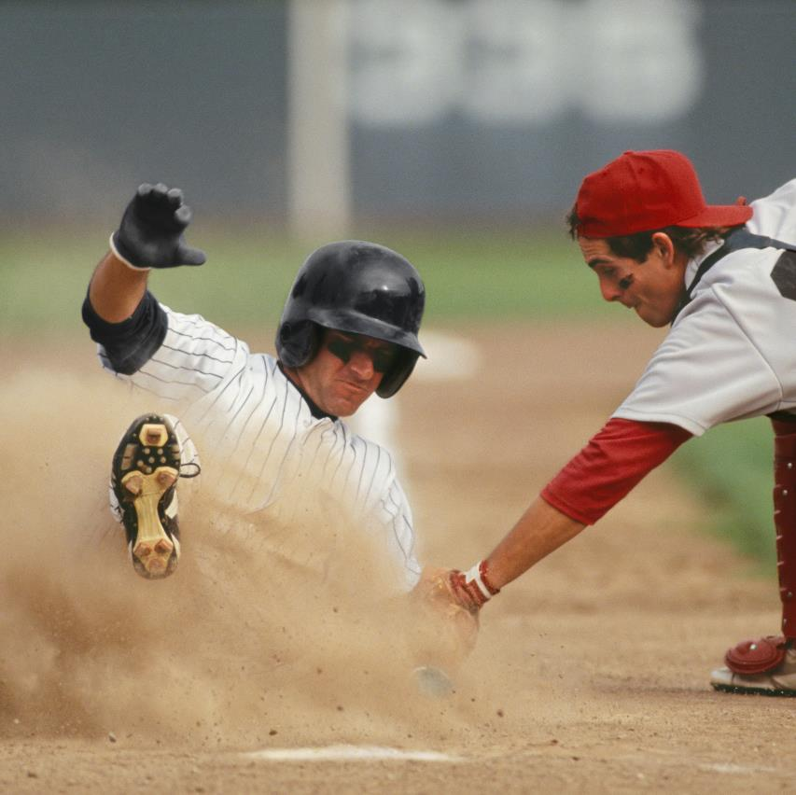
Baseball Problem: Who is going to win, in real-time, by inning?
Data Available: Game Outcomes
Scores by Inning
Can predictive models predict the outcome of a game prior to the 9th inning?
How early and with what accuracy can a predictive model predict the Outcome?

Slide 7
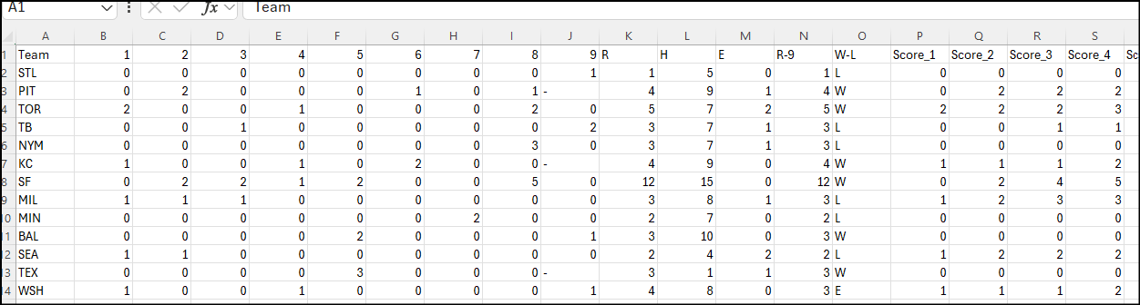
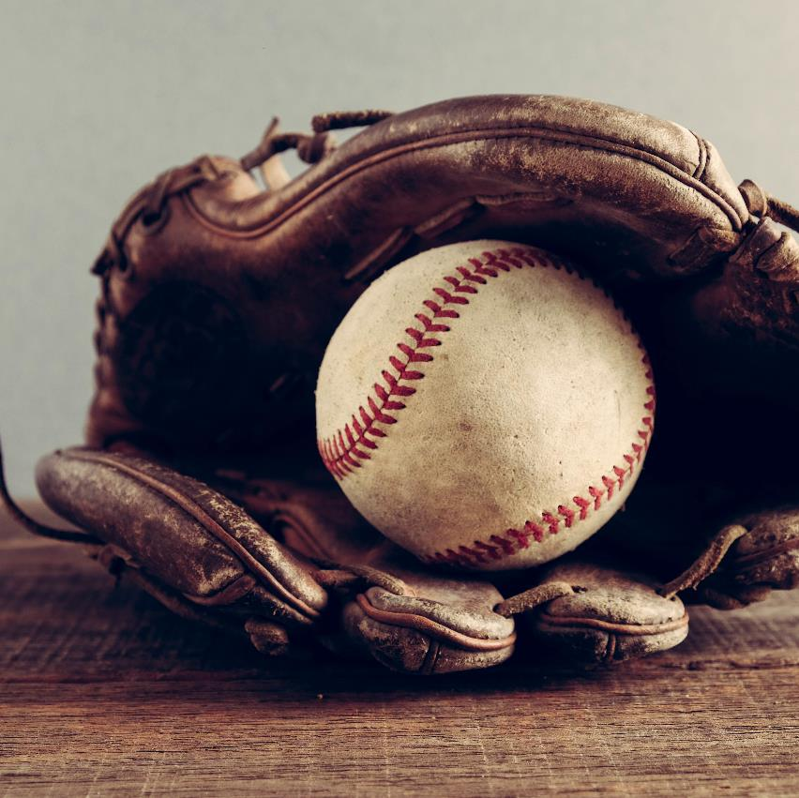
Data and Data Source
https://www.kaggle.com/datasets/josephvm/mlb-game-data Joseph Mohr
Start of 2016 season through end of the 2021 post-season.
Over 25,000 lines of data with Scores by Inning
Each Individual Row is one Team. Each pair of Lines are an Individual Game

Slide 8

Data Cleaning Summary
Discovered All-Star Games included in the Data.
Some Games were Cancelled Prior to 9 Innings
Some Games Had Extra Innings
Numbers were in both Integers and Strings
Final Data Set included Only Games that concluded in 9 innings.

Slide 9
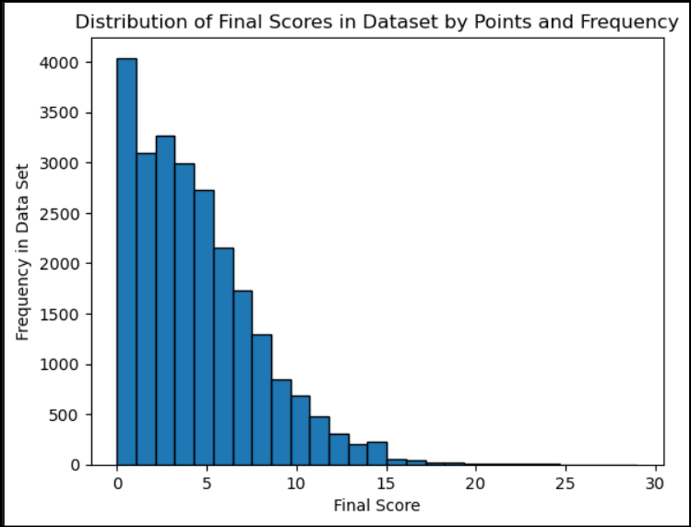
Data Cleaning Summary
Graphic Visualization of Test and Train Data
Scores are typically Low and Games are Close.
This is expected to impact the Ability to Predict Who Wins.

Slide 10
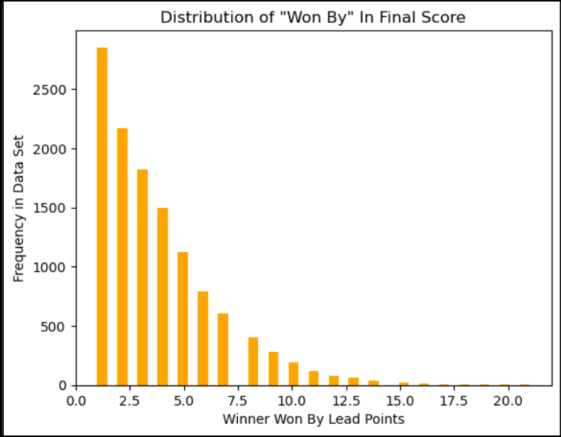
Data Cleaning Summary
Graphic Visualization of Test and Train Data
Scores are typically Low and Games are Close.
This is expected to impact the Ability to Predict Who Wins.

Slide 11
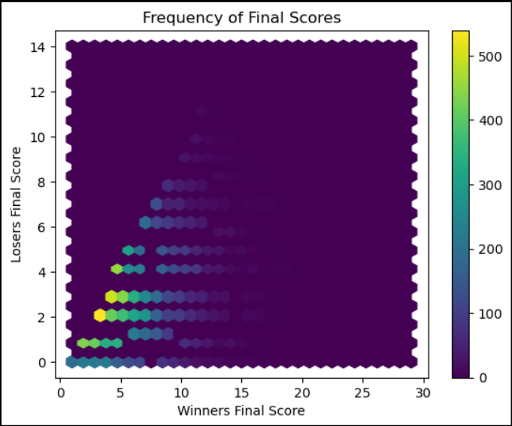
Data Cleaning Summary
Graphic Visualization of Test and Train Data
Scores are typically Low and Games are Close.
This is expected to impact the Ability to Predict Who Wins.

Slide 12
Primary Model Selection: Random Forest Model
Typically This is an Accurate Model, especially for data sets with multiple variables.
Variable: Runs per Inning
Score at end of Each inning
Score Lead
Final data Set varied from 2 columns (1st inning) to 44 Columns (9th Inning)

Slide 13

Testing Random Forest Model Application And Data With 9th Inning Results
With the Final Scores Available, Random Forest Model Correctly Predicted 100% Test and Train models as Expected

Slide 14
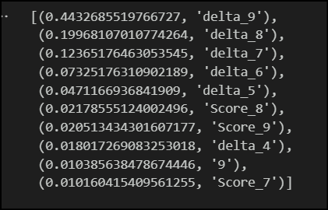
Testing Random Forest Model Application And Data With 9th Inning Results
Importances Indicated As Expected that the Lead from Inning to Inning was Most Impactful Variable.

Slide 15
Testing Random Forest Model Application: 1st through 8th Innings
Importances Indicated As Expected that the Lead from Inning to Inning was Most Impactful Variable.

Slide 16
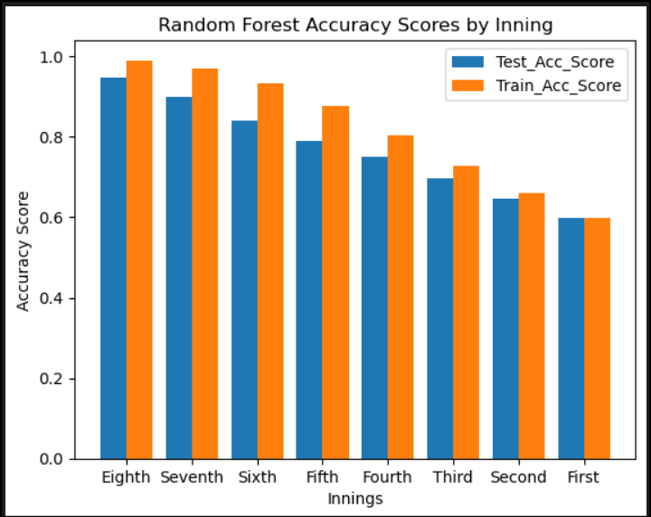
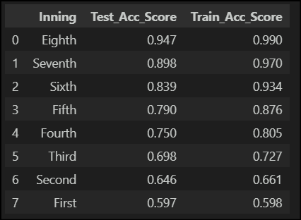
Results Random Forest Model Application: 1st through 8th Innings

Slide 17
Other Models First Inning (Similar Results)
Model | Train Accuracy | Test Accuracy
Random Forest | 60% | 60%
Logical Regression | 60% | 60%
Support Vector Machine | 60% | 60%
KNN Model | 54% | 55%
Decision Tree Classifier | 60% | 60%

Slide 18
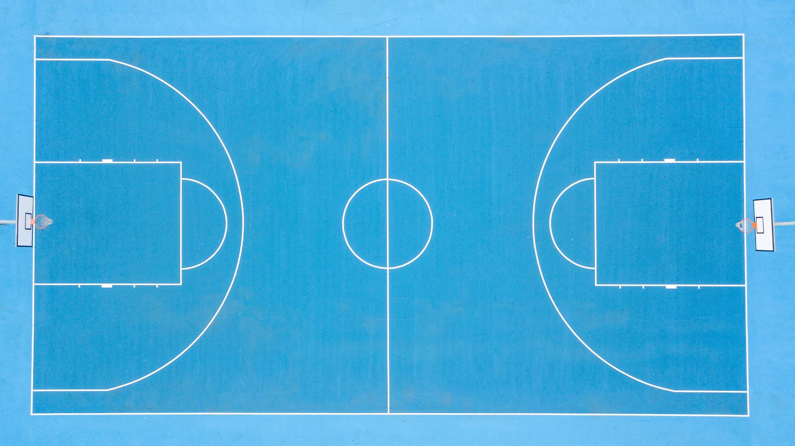
Basketball Predictive Model

Slide 19

Overcoming nervousness
Confidence-building
strategies

Slide 20
Selecting visual aids
Enhancing your
presentation

Slide 21
Effective delivery techniques
This is a powerful tool in public speaking. It involves varying pitch, tone, and volume to convey emotion, emphasize points, and maintain interest.
Pitch variation
Tone inflection
Volume control
Effective body language enhances your message, making it more impactful and memorable.
Meaningful eye contact
Purposeful gestures
Maintain good posture
Control your expressions

Slide 22
Navigating Q&A sessions
Know your material in advance
Anticipate common questions
Rehearse your responses
Maintaining composure during the Q&A session is essential for projecting confidence and authority. Consider the following tips for staying composed:
Stay calm
Actively listen
Pause and reflect
Maintain eye contact

Slide 23

Speaking impact
Your ability to communicate effectively will leave a lasting impact on your audience
Effectively communicating involves not only delivering a message but also resonating with the experiences, values, and emotions of those listening

Slide 24
Dynamic delivery
Learn to infuse energy into your delivery to leave a lasting impression
One of the goals of effective communication is to motivate your audience
Metric | Measurement | Target | Actual
Audience attendance | # of attendees | 150 | 120
Engagement duration | Minutes | 60 | 75
Q&A interaction | # of questions | 10 | 15
Positive feedback | Percentage (%) | 90 | 95
Rate of information retention | Percentage (%) | 80 | 85

Slide 25
Final tips & takeaways
Consistent rehearsal
Strengthen your familiarity
Refine delivery style
Pacing, tone, and emphasis
Timing and transitions
Aim for seamless, professional delivery
Practice audience
Enlist colleagues to listen & provide feedback
Seek feedback
Reflect on performance
Explore new techniques
Set personal goals
Iterate and adapt

Slide 26
Speaking engagement metrics
Impact factor | Measurement | Target | Achieved
Audience interaction | Percentage (%) | 85 | 88
Knowledge retention | Percentage (%) | 75 | 80
Post-presentation surveys | Average rating | 4.2 | 4.5
Referral rate | Percentage (%) | 10 | 12
Collaboration opportunities | # of opportunities | 8 | 10

Slide 27
Thank you
Krishan Fotedar
Cristina Frisby

